Slide 1
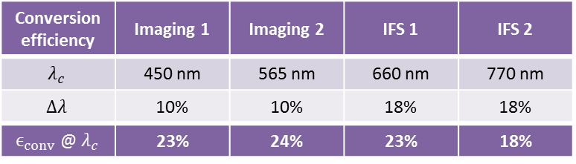
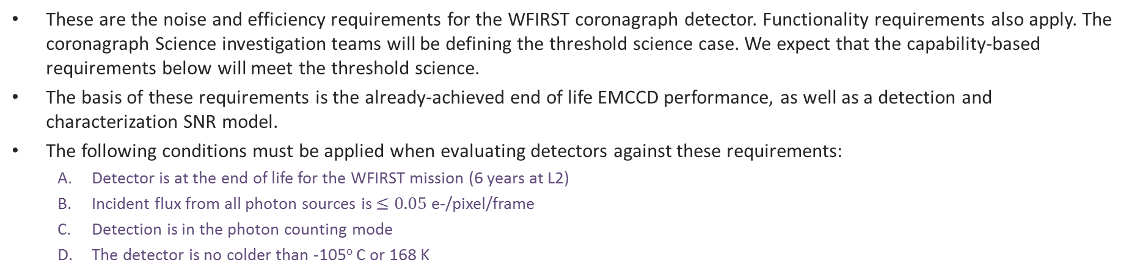
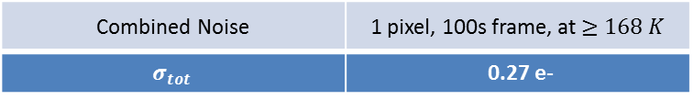
WFIRST Coronagraph Detector Requirements
These are the noise and efficiency requirements for the WFIRST coronagraph detector. Functionality requirements also apply. The coronagraph Science investigation teams will be defining the threshold science case. We expect that the capability-based requirements below will meet the threshold science.
The basis of these requirements is the already-achieved end of life EMCCD performance, as well as a detection and characterization SNR model.
The following conditions must be applied when evaluating detectors against these requirements:
Detector is at the end of life for the WFIRST mission (6 years at L2)
Incident flux from all photon sources is $≤0.05$e-/pixel/frame
Detection is in the photon counting mode
The detector is no colder than -105º C or 168 K
Conversion Efficiency
Defined as the fraction of times a single incident photon is counted as a single photon and includes
Quantum Efficiency
Charge transfer efficiency (where applicable)
Photon counting efficiency (thresholding efficiency)
Total Noise from one pixel in a 100-second frame
Defined as the standard deviation of the combined detector noise contributions from:
Read noise
Dark current
Clock induced charge (CIC, where applicable)
Conversion efficiency | Imaging 1 | Imaging 2 | IFS 1 | IFS 2
$$λ_{c}$$ | 450 nm | 565 nm | 660 nm | 770 nm
$$Δλ$$ | 10% | 10% | 18% | 18%
$ϵ_{conv}$ @ $λ_{c}$ | 23% | 24% | 23% | 18%
Combined Noise | 1 pixel, 100s frame, at $≥168 K$
$$σ_{tot}$$ | 0.27 e-

Slide 2
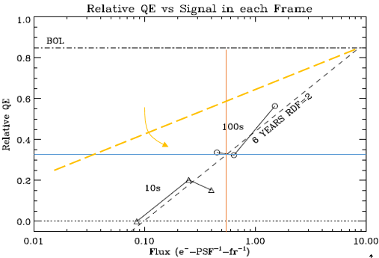
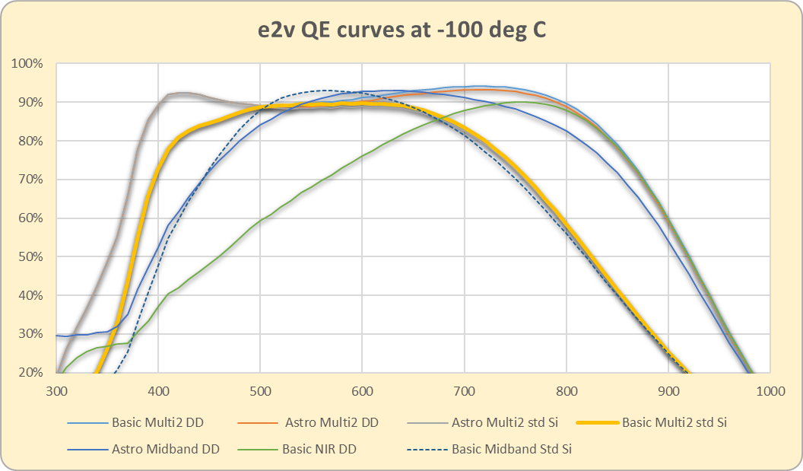
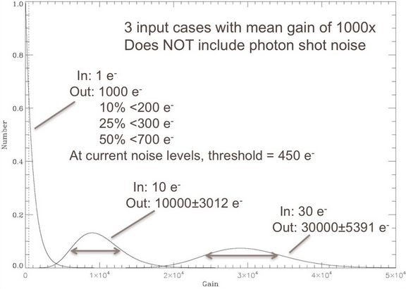
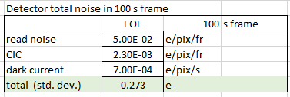
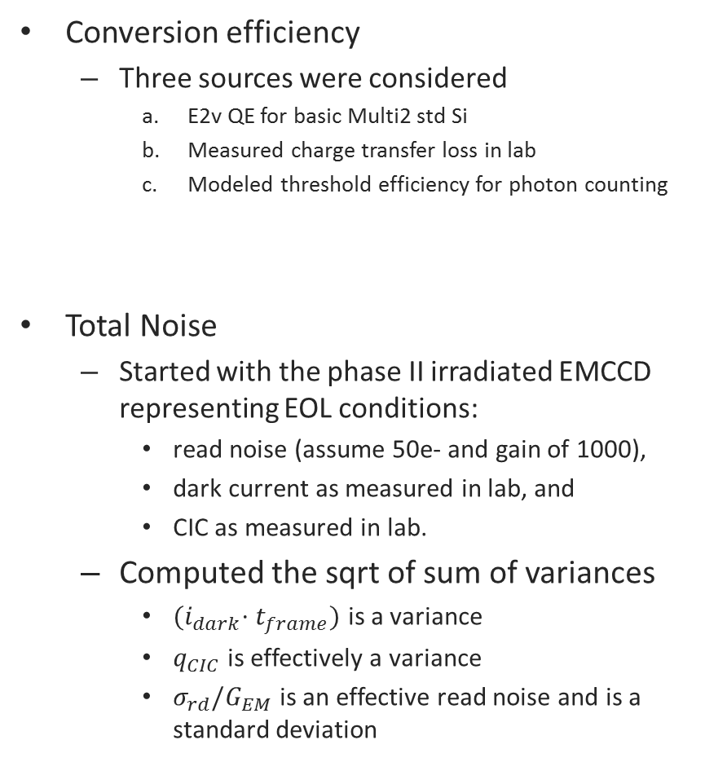
Backup information for CGI system engineering
Conversion efficiency
Three sources were considered
E2v QE for basic Multi2 std Si
Measured charge transfer loss in lab
Modeled threshold efficiency for photon counting
Total Noise
Started with the phase II irradiated EMCCD representing EOL conditions:
read noise (assume 50e- and gain of 1000),
dark current as measured in lab, and
CIC as measured in lab.
Computed the sqrt of sum of variances
${(i}_{dark}⋅t_{frame})$ is a variance
$q_{CIC}$ is effectively a variance
$σ_{rd}/G_{EM}$ is an effective read noise and is a standard deviation
b
a
c

